Slide 1

Domain: MATLAB
Technology: COMMUNICATION
A NODE OVERHAUL SCHEME FOR ENERGY EFFICIENT CLUSTERING IN WIRELESS SENSOR NETWORKS

Slide 2
Index
Abstract
Introduction
Literature review
Existing Method
Disadvantages
Proposed method
Advantages
Applications
Hardware and Software Requirements
Results
Conclusion
References

Slide 3
Abstract
Clustering of wireless sensor network nodes, a fundamental operation, is aimed at achieving load balancing and prolonged network lifetime. Low-energy adaptive clustering hierarchy protocol, the prominent standard, achieves these. An improved protocol, balance cluster formation, provides the additional advantage of equal size clusters, but at the cost of overlapping of clusters. This letter presents a node overhaul scheme that achieves load balancing and energy efficiency while also maintaining uniform size clusters without any overlapping. The proposed solution first forms initial clusters and later refurbishes the initial clusters based on a second best choice cluster head, wherever applicable. The results so obtained show a substantial improvement in network lifetime and node death rate as compared to other simulated methods.
Index Terms: Sensor networks, energy efficiency, load balancing, network lifetime, uniform size clusters (USCs).

Slide 4
Introduction:
Wireless sensor networks consist of a large number of spatially distributed autonomous sensor nodes deployed to monitor the physical environmental conditions [1]. Due to the highly resource constrained nature of a sensor node, a wireless sensor network needs to be well designed from energy conservation perspective [2]. In the literature, clustering methodology has been investigated to conserve the energy of sensor nodes in the deployed wireless sensor network. Heinzelman et al. [3] have proposed low-energy adaptive clustering hierarchy (LEACH) protocol, considered as the umbrella protocol for clustering approaches, to extend the network lifetime. LEACH states that the resultant clusters should be of same size to load balance the network for better energy consumption in nodes, which has been also emphasized by [4]–[6]. However, LEACH and its various variants do not guarantee the formation of equal size clusters due to the their random nature

Slide 5
Literature review:
S. NO | Journal Type with year | Authors | Title | Outcomes
1 | Comput. Netw., vol. 144, pp. 89–110, 2018 | F. Karray, M. W. Jmal, A. Garcia-Ortiz, M. Abid, and A. M. Obeid. | "A comprehensive survey on wireless sensor node hardware platforms." | Studied about WSN hardware platforms
2 | Comput. Netw., vol. 180, 2020, Art. no. 107376., | A. Shahraki, A. Taherkordi, Ø. Haugen, and F. Eliassen, | “Clustering objectives in wireless sensor networks: A survey and research direction analysis,,” | Studied about Clustering
3 | IEEE Trans. Wireless Commun., vol. 1, no. 4, pp. 660–670, Oct. 2002. | Heinzelman, Wendi Rabiner, Anantha Chandrakasan, and Hari Balakrishnan. | "An application-specific protocol architecture for wireless microsensor networks." | Studied about wireless microsensor networks
4 | Comput. Netw., vol. 38, no. 4, pp. 393–422, 2002. | I. Akyildiz, W. Su, Y. Sankarasubramaniam, and E. Cayirci, | ““Wireless sensor networks: A survey,” | Studied about survey of WSN
5 | ” Wireless Pers. Commun., vol. 82, no. 2, pp. 995–1012, May 2014.. | H. Shin, S. Moh, I. Chung, and M. Kang, | "“Equal-size clustering for irregularly deployed wireless sensor network." | Studied about Equal size Clustering

Slide 6
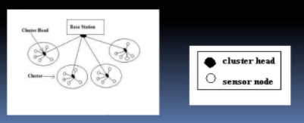
Existing method:
The first proposed clustering protocol is the LEACH(LOW ENERGY ADAPTIVE CLUSTERING HIERARCHY) protocol . The operation of LEACH protocol consists of several rounds with two phases in each :Set-up Phase and Steady Phase.
The Set-Up Phase where Cluster Heads are chosen and Cluster Formation are done. In steady state Phase the data transmission takes place between nodes to CH and CH to BS.The main idea is to choose the CH in a clustered manner at each round and then have the nodes join the closest CH to form a dynamic cluster. This network topology is built on the chosen CHs, which is inefficient due to the lack of consideration for node residual energy. Furthermore, prioritising CH selection results in the forming of complex clusters at each round, resulting in an increase in energy overhead due to cluster formation after each re-selection phase for CHs .

Slide 7
Disadvantages in Existing methods:
1. It does not guarantee the formation of equal size clusters.
2. LEACH disregards the BS and cluster head geographical positions, energy consumption, which reduces network lifetime
3. We have noticed that the cluster head missions are more than the ordinary nodes, so the cluster head consumes more energy than the others

Slide 8
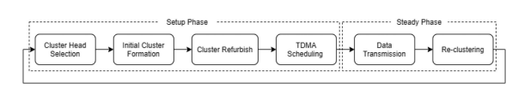
Proposed method:
The proposed LEACH-USC approach has the following three objectives: 1) to generate clusters of uniform size 2) to achieve clusters with crisp boundaries 3) longevity of the network lifetime
In the proposed solution, all the nodes are assigned with a cluster head as it happens in case of LEACH protocol, but there will be a few unclustered nodes because of threshold Thcluster. The idea of the cluster refurbish phase of the proposed solution is to allow extra nodes (MNs—Thcluster) of large clusters to join other clusters according to the second best choice of cluster heads,the proposed solution has uniform size clusters (USCs); thus, the approach is named as LEACH-USC), along with reduced intracluster communication.
Fig. Sequence of operations in the proposed LEACH-USC.

Slide 9
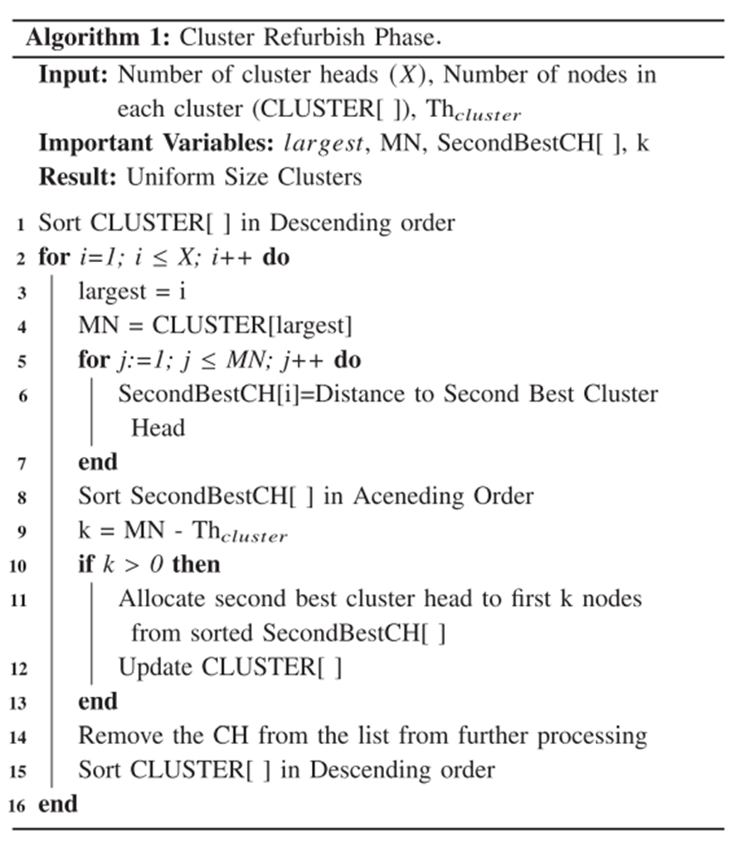
Proposed method:
Cluster head selection depends on the probabilistic approach as also performed by LEACH. In the initial cluster formation operation, all the nodes join the nearest cluster head. As a consequence of probabilistic cluster head selection and assigning the nodes to the nearest clusters head, clusters of different sizes exist after the completion of initial cluster formation operation like the LEACH approach.
In the cluster refurbish operation of the proposed approach, clusters will be reorganized to obtain USCs with the goal of sending the nodes from the a large clusters to the other clusters according to the second best cluster head. First, the largest cluster among all clusters has been identified, and then, the distance between the MNs of the cluster and the rest of the cluster heads are calculated. This is done in order to find second best choice of cluster heads. The k-nodes [MN—Thcluster], which have least communication distance to other cluster heads, will be assigned to respective second best cluster heads. Consequently, nodes near the cluster boundary will be assigned to other cluster heads. Algorithm 1 explains the working of the cluster refurbish process.

Slide 10
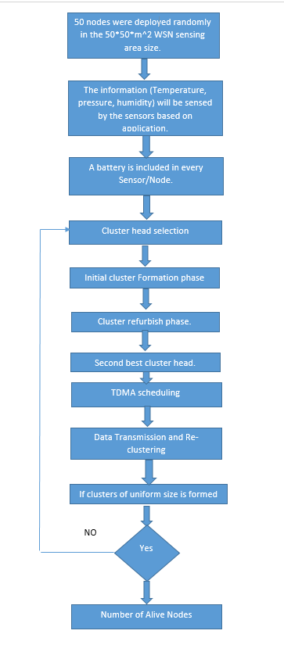
Fig. Flow of proposed modified LEACH.

Slide 11

LEACH do not guarantee the formation of equal size clusters due to the their random nature and doesn’t have crisp boundaries , which leads to an increase in intracluster communication distance. each cluster can have maximum Thcluster member nodes (MNs), which is given by the following equation:
where N denotes the number of nodes in the network, and X represents the count of cluster heads. It is possible that a few nodes may remain unclustered.
In the proposed solution, the cluster formation process has been carried out in the following two steps: The first is the initial cluster formation phase, and the second is the cluster refurbish phase.
In the proposed solution. The idea of the cluster refurbish phase of the proposed solution is to allow extra nodes (MNs—Thcluster) of large clusters to join other clusters according to the second best choice of cluster heads.
The operation of the proposed strategy is as follows:. Cluster head selection depends on the probabilistic approach as also performed by LEACH. In the initial cluster formation operation, all the nodes join the nearest cluster head.
As a consequence of probabilistic cluster head selection and assigning the nodes to the nearest clusters head, clusters of different sizes exist after the completion of initial cluster formation operation. In the cluster refurbish operation of the proposed approach, clusters will be reorganized to obtain USCs with the goal of sending the nodes from the a large clusters to the other clusters according to the second best cluster head.
First, the largest cluster among all clusters has been identified, and then, the distance between the MNs of the cluster and the rest of the cluster heads are calculated. This is done in order to find second best choice of cluster heads. The k-nodes [MN—Thcluster], which have least communication distance to other cluster heads, will be assigned to respective second best cluster heads. Consequently, nodes near the cluster boundary will be assigned to other cluster heads

Slide 12
Cluster refurbish Algorithm : explains the working of the cluster refurbish process. The inputs provided in the algorithm includes: number of cluster heads (X ), number of nodes in each cluster (CLUSTER[]), Thcluster.
First, the largest cluster is identified. Then, the second best distance of the MNs of the largest cluster is found so that they can join the second best cluster head. These distances are then arranged in ascending order and this step is necessary to ensure that nodes, which are closer to the clusters other than their respective clusters will join them and not the one which are farther away from them. Finally, the first k nodes (k = CLUSTER[largest] − Thcluster) from SecondBestCH[] will be sent from the largest cluster to their new clusters according to the second best distance. This process will continue until we have all the clusters of uniform size
After the cluster refurbish process, the TDMA schedule is created by each cluster head in the network according to the number of nodes in each cluster. In the data transmission phase, nodes will send data to their respective cluster heads, and cluster heads will aggregate the data and transmit the aggregated data to the base station. Eventually, reclustering is done to rotate the role of the cluster heads for the next round.
Please read the points and flow too .

Slide 13
Advantages of Proposed method:
1) Longevity of the network lifetime
2) To generate clusters of uniform size
3) To achieve clusters with crisp boundaries

Slide 14
Applications:
1.Industrial control
2.Environmental monitoring,
3. Military surveillance,
4.Intelligent transportation systems and medical field.
5.Furthermore, it can function independently in harsh or high-risk places where human presence is not possible
6.Disaster relief operations.
7.Biodiversity mapping
8.monitoring of temperature, pressure, and humidity

Slide 15
Hardware and Software Requirements:
Hardware & Software Requirements:
Software: Matlab R2018a.
Hardware:
Operating Systems:
• Windows 10
• Windows 7 Service Pack 1
• Windows Server 2019
• Windows Server 2016
Processors:
Minimum: Any Intel or AMD x86-64 processor
Recommended: Any Intel or AMD x86-64 processor with four logical cores and AVX2 instruction set support
Disk:
Minimum: 2.9 GB of HDD space for MATLAB only, 5-8 GB for a typical installation
Recommended: An SSD is recommended a full installation of all Math Works products may take up to 29 GB of disk space
RAM:
Minimum: 4 GB
Recommended: 8 GB

Slide 16
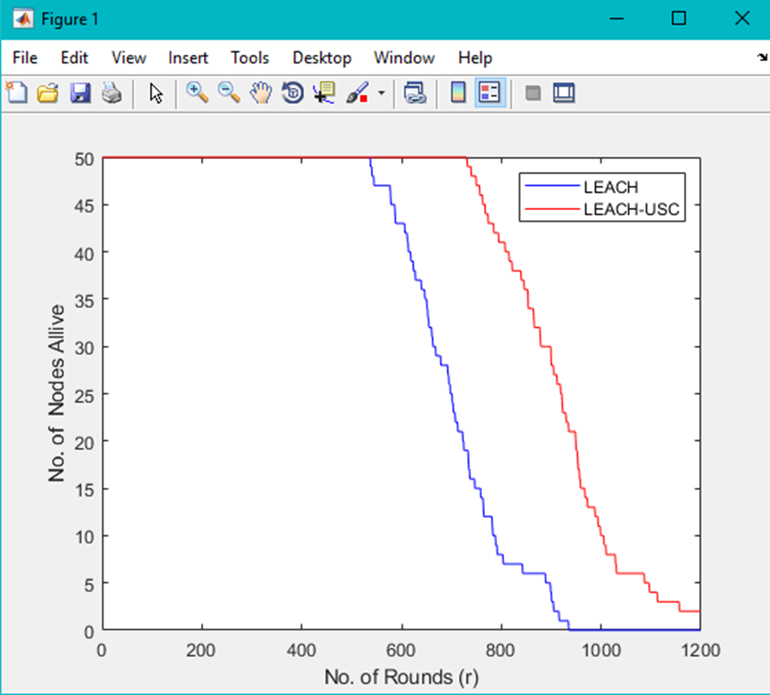
Results and Discussions:
Fig:Node death rate comparison for LEACH and LEACH-USC.

Slide 17
CONCLUSION:
The wireless sensor networks are widely used in different areas. LEACH protocol is one of the most popular approaches in WSN. In this paper, The clustering approach, LEACH-USC, proposed in this article focuses on the balancing the load of the network by creating clusters of uniform size. The proposed LEACH-USC has established good quality clusters, in terms of cluster size and total intracluster communication distance. Simulation results show that LEACH-USC in comparison to LEACH.

Slide 18
References:
[1] F. Karray, M. W. Jmal, A. Garcia-Ortiz, M. Abid, and A. M. Obeid, “A comprehensive survey on wireless sensor node hardware platforms,” Comput. Netw., vol. 144, pp. 89–110, 2018.
[2] A. Shahraki, A. Taherkordi, Ø. Haugen, and F. Eliassen, “Clustering objectives in wireless sensor networks: A survey and research direction analysis,” Comput. Netw., vol. 180, 2020, Art. no. 107376.
[3] W. B. Heinzelman, A. P. Chandrakasan, and H. Balakrishnan, “An application-specific protocol architecture for wireless microsensor networks,” IEEE Trans. Wireless Commun., vol. 1, no. 4, pp. 660–670, Oct. 2002.
[4] I. Akyildiz, W. Su, Y. Sankarasubramaniam, and E. Cayirci, “Wireless sensor networks: A survey,” Comput. Netw., vol. 38, no. 4, pp. 393–422, 2002.
[5] H. Shin, S. Moh, I. Chung, and M. Kang, “Equal-size clustering for irregularly deployed wireless sensor networks,” Wireless Pers. Commun., vol. 82, no. 2, pp. 995–1012, May 2014.

